Slide 1

Apply Yourself
TAKE FIVE
Jennifer Darby
Debra Wu
Michael Bien
Jinah Porter
Notes:
Welcome to Team Take Five’s final presentation. Introduce us…came together to inspect multiple datasets to get our project going. We used binary classification models to work through them and determine the best fit.

Slide 2

Overview
In light of the recent pandemic, COVID-19, many people are struggling financially due to the loss of their job, lower hours or overtime pay.
Credit Card companies determine an applicant’s risk based upon multiple metrics. It is important to understand how these factors can predict one’s ability to pay.
Notes:
With the recent COVID-19’s impact on the world economy, we know many people are struggling financially. For some losing their job or having hours reduced are faced with trying to fill the gap in income with credit. We were interested in how credit card companies determine an applicant’s risk. For our project, we used machine learning models to better predict an applicant’s ability to pay based upon these metrics, created a flask server, pickled our model and created a website allowing credit seekers to apply for credit at Take Five Credit. Debra will walk you through the details of the model…

Slide 3
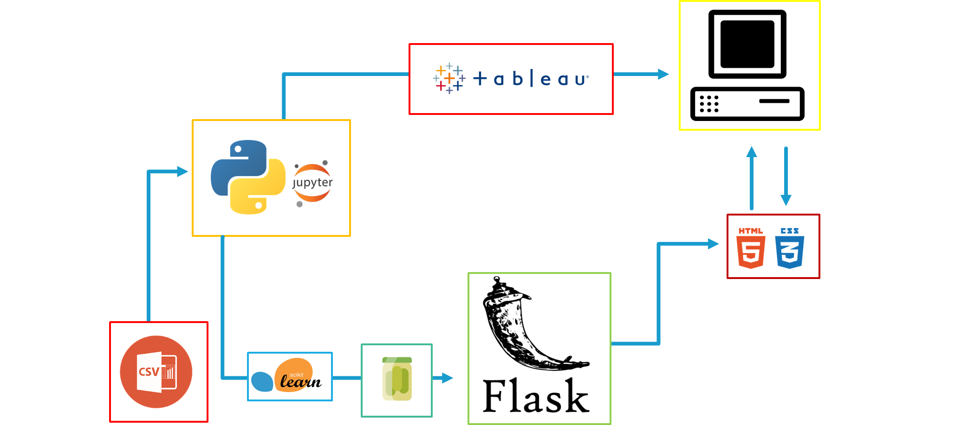
Project Workflow
Notes:
We chose kaggle credit application and used two machine learning models for binary classification. The Logistic regression model returned 0.96, so we serialized the data using Python Pickle module and loaded our results using a flask server to a custom webpage

Slide 4
Project Demo

